Slide 1
EPHESIANS
THE BOOK OF

Slide 2
Just as our bodies have many parts and each part has a special function, so it is with Christ’s body. We are many parts of one body, and individually members of one another.
—Romans 12:4-5

Slide 3
Ephesians 4
⁷ But to each one of us grace has been given as Christ apportioned it.

Slide 4
Ephesians 4
⁷ But to each one of us grace has been given as Christ apportioned it.
In this case, however, “grace” refers to spiritual gifts.

Slide 5
Ephesians 4
⁷ But to each one of us grace has been given as Christ apportioned it.
Unity in Diversity
“The highest expression of individuality can only be found in community.”

Slide 6
Ephesians 4
⁷ But to each one of us grace has been given as Christ apportioned it.
⁸ This is why it says: “When he ascended on high, he took many captives and gave gifts to his people.”

Slide 7
Ephesians 4
⁷ But to each one of us grace has been given as Christ apportioned it.
⁸ This is why it says: “When he ascended on high, he took many captives and gave gifts to his people.”
There is a textual problem.
Psalm 68:17-18: The chariots of God are tens of thousands and thousands of thousands; the Lord has come from Sinai into his sanctuary. When you ascended on high, you led captives in your train; you received gifts from men.

Slide 8
Ephesians 4
⁷ But to each one of us grace has been given as Christ apportioned it.
⁸ This is why it says: “When he ascended on high, he took many captives and gave gifts to his people.”
There is a textual problem.
John Stott: “What conquerors took from their captives, they gave away to their own people. The spoils were divided, the booty was shared. It seems possible that the Hebrew text itself may imply this…

Slide 9
Ephesians 4
⁷ But to each one of us grace has been given as Christ apportioned it.
⁸ This is why it says: “When he ascended on high, he took many captives and gave gifts to his people.”
There is a textual problem.
John Stott: “Since the verb could be translated ‘brought’ rather than ‘received’, and it is not without significance that two ancient versions or translations [of the Old Testament], one Aramaic and the other Syriac, render it ‘gave.’”

Slide 10
Ephesians 4
⁹ (What does “he ascended” mean except that he also descended to the lower, earthly regions?
¹⁰ He who descended is the very one who ascended higher than all the heavens, in order to fill the whole universe.)

Slide 11
Ephesians 4
¹¹ So Christ himself gave the apostles, the prophets, the evangelists, the pastors and teachers

Slide 12
Ephesians 4
¹¹ So Christ himself gave the apostles, the prophets, the evangelists, the pastors and teachers

Slide 13
Ephesians 4
¹¹ So Christ himself gave the apostles, the prophets, the evangelists, the pastors and teachers

Slide 14
Ephesians 4
¹¹ So Christ himself gave the apostles, the prophets, the evangelists, the pastors and teachers

Slide 15
Ephesians 4
¹¹ So Christ himself gave the apostles, the prophets, the evangelists, the pastors and teachers

Slide 16
Ephesians 4
¹¹ So Christ himself gave the apostles, the prophets, the evangelists, the pastors and teachers
¹² to equip his people for works of service, so that the body of Christ may be built up

Slide 17
Ephesians 4
¹¹ So Christ himself gave the apostles, the prophets, the evangelists, the pastors and teachers
¹² to equip his people for works of service, so that the body of Christ may be built up
There are several advantages to this equipping model
» It argues against a man-centered church.
» Basing the operation and growth of the entire church on a single, gifted person would be like having a massively enlarged heart.

Slide 18
Ephesians 4
¹¹ So Christ himself gave the apostles, the prophets, the evangelists, the pastors and teachers
¹² to equip his people for works of service, so that the body of Christ may be built up
Healthy organisms grow

Slide 19
Ephesians 4
¹¹ So Christ himself gave the apostles, the prophets, the evangelists, the pastors and teachers
¹² to equip his people for works of service, so that the body of Christ may be built up
As each part does its work

Slide 20
Ephesians 4
¹¹ So Christ himself gave the apostles, the prophets, the evangelists, the pastors and teachers
¹² to equip his people for works of service, so that the body of Christ may be built up
¹³ until we all reach unity in the faith and in the knowledge of the Son of God and become mature, attaining to the whole measure of the fullness of Christ.

Slide 21
Ephesians 4
¹¹ So Christ himself gave the apostles, the prophets, the evangelists, the pastors and teachers
¹² to equip his people for works of service, so that the body of Christ may be built up
¹³ until we all reach unity in the faith and in the knowledge of the Son of God and become mature, attaining to the whole measure of the fullness of Christ.

Slide 22
Ephesians 4
¹¹ So Christ himself gave the apostles, the prophets, the evangelists, the pastors and teachers
¹² to equip his people for works of service, so that the body of Christ may be built up
¹³ until we all reach unity in the faith and in the knowledge of the Son of God and become mature, attaining to the whole measure of the fullness of Christ.

Slide 23
Ephesians 4
¹¹ So Christ himself gave the apostles, the prophets, the evangelists, the pastors and teachers
¹² to equip his people for works of service, so that the body of Christ may be built up
¹³ until we all reach unity in the faith and in the knowledge of the Son of God and become mature, attaining to the whole measure of the fullness of Christ.

Slide 24
Ephesians 4
¹⁴ Then we will no longer be infants, tossed back and forth by the waves, and blown here and there by every wind of teaching and by the cunning and craftiness of people in their deceitful scheming.

Slide 25
Ephesians 4
¹⁴ Then we will no longer be infants, tossed back and forth by the waves, and blown here and there by every wind of teaching and by the cunning and craftiness of people in their deceitful scheming.

Slide 26
Ephesians 4
¹⁴ Then we will no longer be infants, tossed back and forth by the waves, and blown here and there by every wind of teaching and by the cunning and craftiness of people in their deceitful scheming.
Those who have not attained spiritual maturity are unable to assess truth claims.

Slide 27
Ephesians 4
¹⁴ Then we will no longer be infants, tossed back and forth by the waves, and blown here and there by every wind of teaching and by the cunning and craftiness of people in their deceitful scheming.
The Example of Church History

Slide 28
Ephesians 4
¹⁴ Then we will no longer be infants, tossed back and forth by the waves, and blown here and there by every wind of teaching and by the cunning and craftiness of people in their deceitful scheming.
¹⁵ Instead, speaking the truth in love, we will grow to become in every respect the mature body of him who is the head, that is, Christ.

Slide 29
Ephesians 4
¹⁴ Then we will no longer be infants, tossed back and forth by the waves, and blown here and there by every wind of teaching and by the cunning and craftiness of people in their deceitful scheming.
¹⁵ Instead, speaking the truth in love, we will grow to become in every respect the mature body of him who is the head, that is, Christ.

Slide 30
Truth without love
» Makes people less receptive
» Causes people to feel like a project
» Is ineffective
Love without truth
» We may feel regret because we failed to say something
» No one’s life really changes

Slide 31
Ephesians 4
¹⁶ From him the whole body, joined and held together by every supporting ligament, grows and builds itself up in love, as each part does its work.

Slide 32
Ephesians 4
¹⁶ From him the whole body, joined and held together by every supporting ligament, grows and builds itself up in love, as each part does its work.
1 Peter 5:2: You also, like living stones, are being built into a spiritual house.

Slide 33
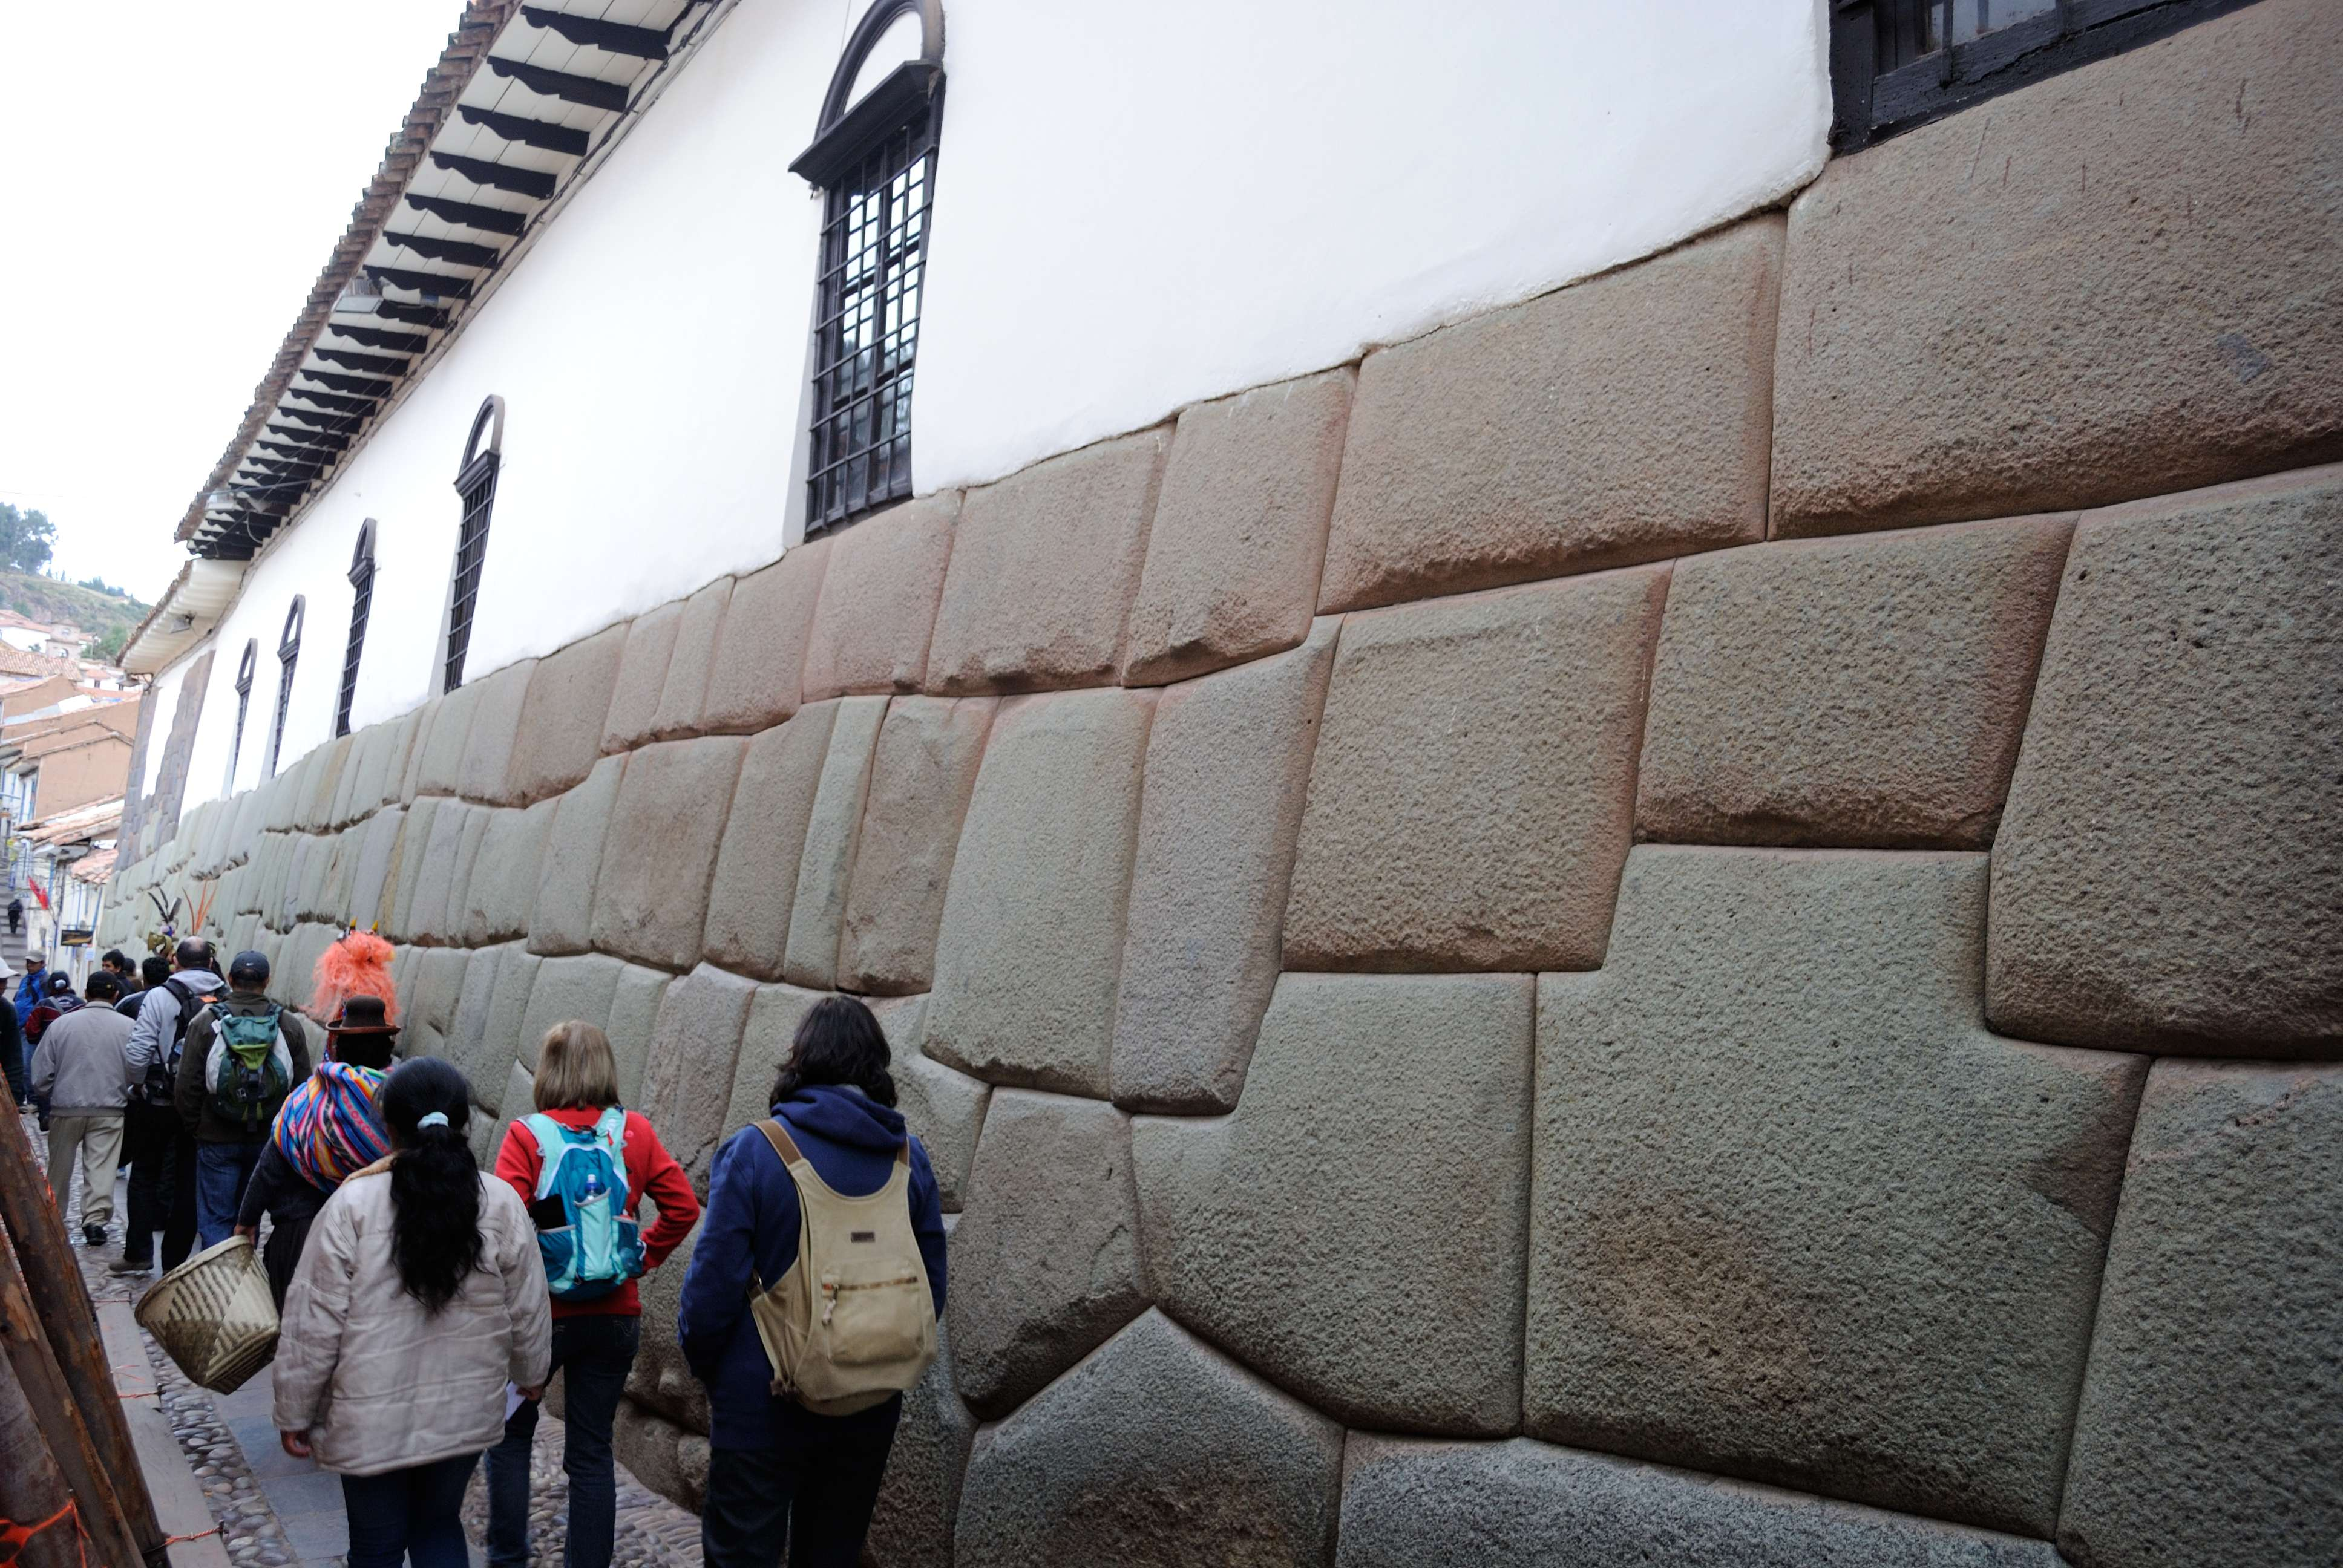

Slide 34
Ephesians 4
¹⁶ From him the whole body, joined and held together by every supporting ligament, grows and builds itself up in love, as each part does its work.

Slide 35
Application
» God offers you an opportunity to be apart of something bigger than yourself

Slide 36
Application
» God offers you an opportunity to be apart of something bigger than yourself while highlighting your individuality.
» Talk your walk with God to the next level by discovering your spiritual gifts.
» Exercise your spiritual gifts and playing your part.

Slide 37
EPHESIANS
THE BOOK OF

